Slide 1


telecare.digitaloffice.scot
Telecare SCAM Alert
Prevention ….
Notes:
With an increase in instances of SCAM’s related to telecare, we are working with others towards detection and prevention.

Slide 2

The SCAM and ASK:
Multiple SCAM versions…….
Centres around digital migration…….
Pressing need for digital unit, line or Broadband………
Planned ACTION
Sharon Hannah
Project Manager for Housing
Notes:
There are multiple versions, not all are voice phishing, some are unscrupulous sales practices. Random in approach so not geographically targeted. All examples from Telecare centre around analogue to digital. One off payment for digital unit or sign up for line/BB but the exact practice is unknown. Best plan is to inform and on-line alert service users, family, carers and staff who visit or take telecare calls.

Slide 3
Prevention-What can we do?
60% of Scotland Digital
Notes:
Prevention - great news is 60% of Scotland now digital/ digitally ready. We know but service users may not. Like “following your car accident” call we have all had, we believe telecare calls may be that sporadic/ random and auto-dialler in nature.

Slide 4




Report
Differing scam types, need clarity especially on voice phishing methods used
Ease of reporting for service users and families or carers
Gather and report scams or attempts
Advice Direct Scotland (ADS) by calling 0808 164 6000: orby visiting www.scamwatch.scot.
Sign-up to Trading Standards ScamShare Bulletin
Trading Standards will collate Scottish data
Alert
Alert service users via web or social media.
Typical format/alert will be provided
Communicate
Alert/ support service users, family or contacts
Update visiting services, staff and ARC’s
If money extracted, urge report to bank
Attempt or actual scam please report to ADS – Advice Direct Scotland, don’t forget this is a CRIME
Digital Office will onward brief regularly and by usual methods and further via Linked-In posts
Keep us informed and share experiences with other ARC/ Telecare services at DT meetings
Notes:
Report, Alert, Communicate – If reporting improves, methods used may be clearer and prevention more targeted. DT are liaising closely with TS (fortnightly meetings) and will provide feedback. Internal and external comms needed, WLC issued one recently which is a good example should I request that TS help us with a more generic version that all could adopt. When SU bank details are disclosed, it’s a crime so report to ADS – Advice Direct Scotland.

Slide 5

Other Approaches
The ASK
Newer version…..need your help
Share with All
BBC Feature
A2D Leaflet
BT Housing Training
Notes:
BBC pitch for a Reporting Scotland feature is ongoing but there is an ask which I will detail in the last slide. A generic leaflet explaining A2D in the home does contain a scam alert and is ready for your logo to be added but I need your help on a wording change that I will highlight in the next slide. Also BT are preparing a national housing pack for scheme staff to communicate/support SU’s during mass migrations, Scotland starts in Summer 25, Digital Telecare will look to share that too.

Slide 6
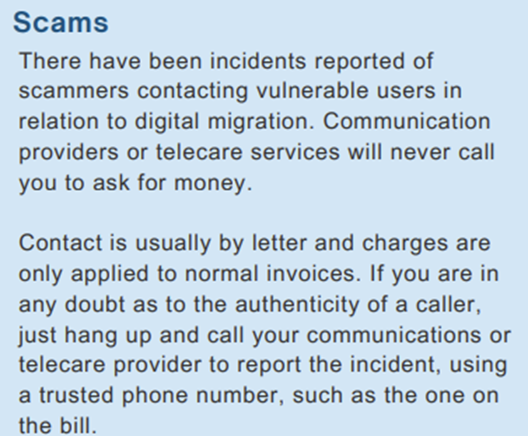
AlliP Leaflet
Contact is usually by letter and charges are only applied to normal invoices. If you are in any doubt as to the authenticity of a caller, just hang up and call your communications provider using a trusted phone number such as the one on the bill. For telecare specific calls you may be suspicious of, press your pendant to your telecare service provider to report the incident.
Notes:
AlliP leaflet is educational, a pre-amble to any CP action. It has a scam alert but want to amend slightly to make it easier for telecare SU and to know they have a trusted route via Pendant/Pull-cord to do so.

Slide 7

The ASK…..
• Telecare A2D Installation Process
• Standard communication to Service Users
• Filming an A2D installation
• Filming a user who has been a scammed
• Filming a user where a scam has been attempted
• A2D Leaflet (AlliP version contains Scam Alert)
sharon.hannah@digitaloffice.scot
Notes:
ASK – What does a typical A2D Installation process consists of (letter, phone call, new contract, etc.), what is shared with the SU, what should they expect from Telecare, and we can perhaps add it to the feature. Actual SU experiences will personalise the feature and drive the message into the home; So we need an opportunity to film an A2D instal, attempted/actual scammed user or family/friend.

